Slide 1
Python Quick Camp
TDWI Accelerate - October 2017
Paul Boal - @paulboal

Slide 2
Purpose
Understand the latest trends in Python as a data science tool
Use Python to load, enrich, and analyze real-world data
Manage data using high-performance data structures
pandas, numpy
Visualize data and relationships using plots
matplotlib, pandas, seaborn, plotly, bokeh
Organize complex code libraries using Python modules

Slide 3
Agenda
What’s going on with Python?
Python Quick Camp
Python 101
Real-world scenario
Getting data
Formatting data
Enriching data
Data profiling and analysis
Exercises
Q&A

Slide 4
Universities are Teaching Python
What’s going on with Python?
Fastest growing Q&A topic, especially in colleges and universities.
Growth driven almost entirely from pandas, numpy, matplotlib
https://stackoverflow.blog/2017/09/14/python-growing-quickly/

Slide 5
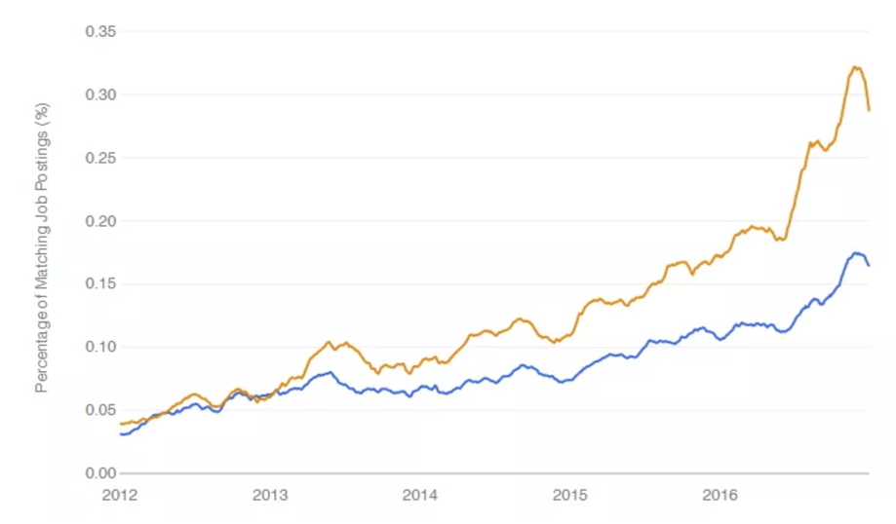
Python is on the rise
What’s going on with Python?
Growing faster than R as a requirement for data science related jobs.
Second only to SQL in technical skills required by a data scientist.
https://www.r-bloggers.com/data-science-job-report-2017-r-passes-sas-but-python-leaves-them-both-behind/

Slide 6
Why choose Python for Data Science?
What’s going on with Python?
A multi-purpose language
Easy to learn syntax
Interactive and reproducible plots
Large and growing data and analytics libraries
Integration with big data platforms (e.g. Spark)
Build complete applications in a single language
Multiple ways to interact with Python: command line, IDE, notebook
https://www.datacamp.com/community/tutorials/r-or-python-for-data-analysis#gs.JoPn0p4

Slide 7
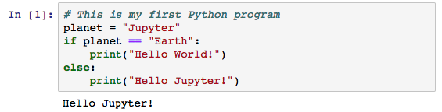
Hello Jupyter!
Comments are preceded by #.
Variables get assigned values with =.
Code blocks require consistent indenting.
Function calls use () to pass parameter values.
Jupyter organizes commands into cells that can hold code or documentation, and have results.
Jupyter is an interactive web-based programming notebook that shows commands and results in-line.
Jupyter launches separate Python interpreters for each running notebook.
Notebooks are independent and do not share variables or data back-and-forth.

Slide 8
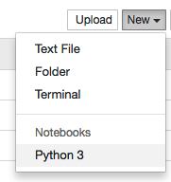

#1 – First Notebook
Create a new Python Notebook in Jupyter
Write your hello world program
Run the current cell with Shift-Enter

Slide 9
Introduction
Business Scenario:
Healthcare costs vary dramatically from one facility to the next, even in the same community.
Are there any geographic features that might be tied to those cost patterns?
Steps:
Getting procedure costs
Get facility information
Get additional external data
Review correlations in data

Slide 10
1. Get Procedure Costs
1. Get Procedure Costs

Slide 11

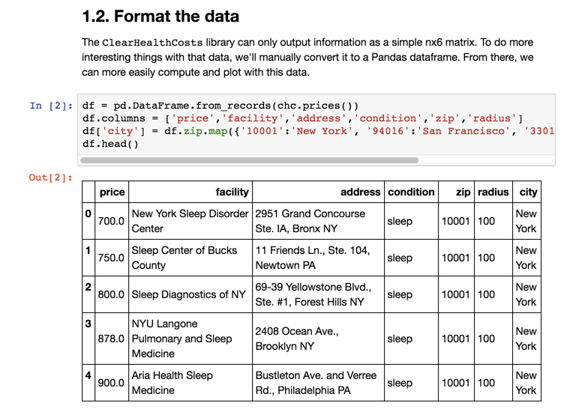
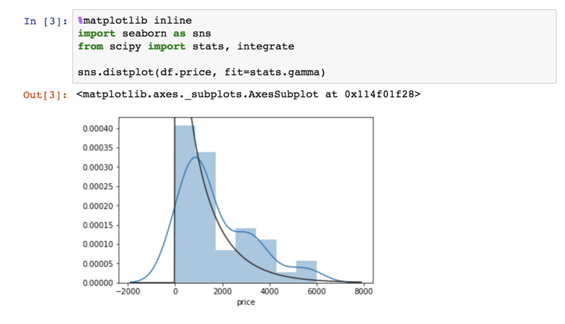
Introducing the Jupyter Notebook
1. Getting procedure costs
Jupyter tool bars
Cell types
Documentation
Code
Output
Print statements
Variable contents
Plots
NOTE: Jupyter saves files with a .ipynb extension. These are structured JSON and contain all of the notebook contents including documentation, code, and visible results. The notebook file does not contain a snapshot of the variable contents – that only exists in the current Python instance.

Slide 12
Using Modules
1. Getting procedure costs

Slide 13
GetPrices Module: Parse HTML with BeautifulSoup
1.1 Get the data

Slide 14
Getting Prices: Thinking in Objects
1.1 Get the data

Slide 15
Processing Data: Introducing the DataFrame
1.2 Format the data

Slide 16
Making Data Readable: Code to Descriptions Maps
1.2 Format the data

Slide 17
Visualizing Price Distribution: Histograms
1.3 Quick data profiling

Slide 18
Plotting Libraries
1.3 Quick data profiling
Package | Uses
matplotlib | Basic plotting capabilities following the paradigms from Matlab designed for scientific publications. Not built with web based notebooks in mind first, but interactive charts are available.
pandas | DataFrames have built-in plotting functions that use matplotlib under the hood.
seaborn | This library makes the default matplotlib plots prettier and adds many functions to make common plotting activities easier.
plotly | Plot.ly is much more than just a plotting library. It’s a comprehensive web service that gives analysts a way to manage and share data, code, and visualizations. Basic and public usage is free, but enterprise services are paid.
bokeh | An Open Source plotting library that makes interactive web graphics easier to create within environments like Jupyter.

Slide 19
Cleaning Bad Data: Filtering a DataFrame
1.4 Check for bad data

Slide 20
Drill Down: Histograms by Series
1.5 Break things down

Slide 21
2. Getting more information about these facilities
2. Get Facility Information

Slide 22
Type of Facility: Natural Language Processing
2.1 Classifying the facilities

Slide 23
Labeling Facility Types: Loops and Conditions
2.2 Label the clusters

Slide 24
Looking at Facility Types: Histograms and Bars
2.3 Compare the distributions by label

Slide 25
3. Get Additional External Data
3. Bring in external data

Slide 26
Clean Addresses: Google Maps Geocoding
3.1 Geocode addresses

Slide 27
Checkpoint Your Data: Saving and Loading Excel
3.1 Geocode addresses

Slide 28
Get Local Population: DataFrames as Lookups
3.2 Census data

Slide 29
Plotting Relationships: Scatterplot / LM Plot
3.2 Census data

Slide 30
4. Review Correlations in Data
4. Look at correlations

Slide 31
Be a Lazy Programmer: Lists, Loops, and Lambda
4.1 Pull in several variables from census

Slide 32
Scatterplot Matrix
4.2 Correlation plot with Plotly

Slide 33
Plotly Gallery

Slide 34
What Else Can I do with Python?

Slide 35
Review of Topics
Variables
Loops
Flow control
Functions
Modules
Web requests
Lists
Dictionaries
Pandas Series
Pandas DataFrames
Plotting
Reading / Writing Excel

